Slide 1
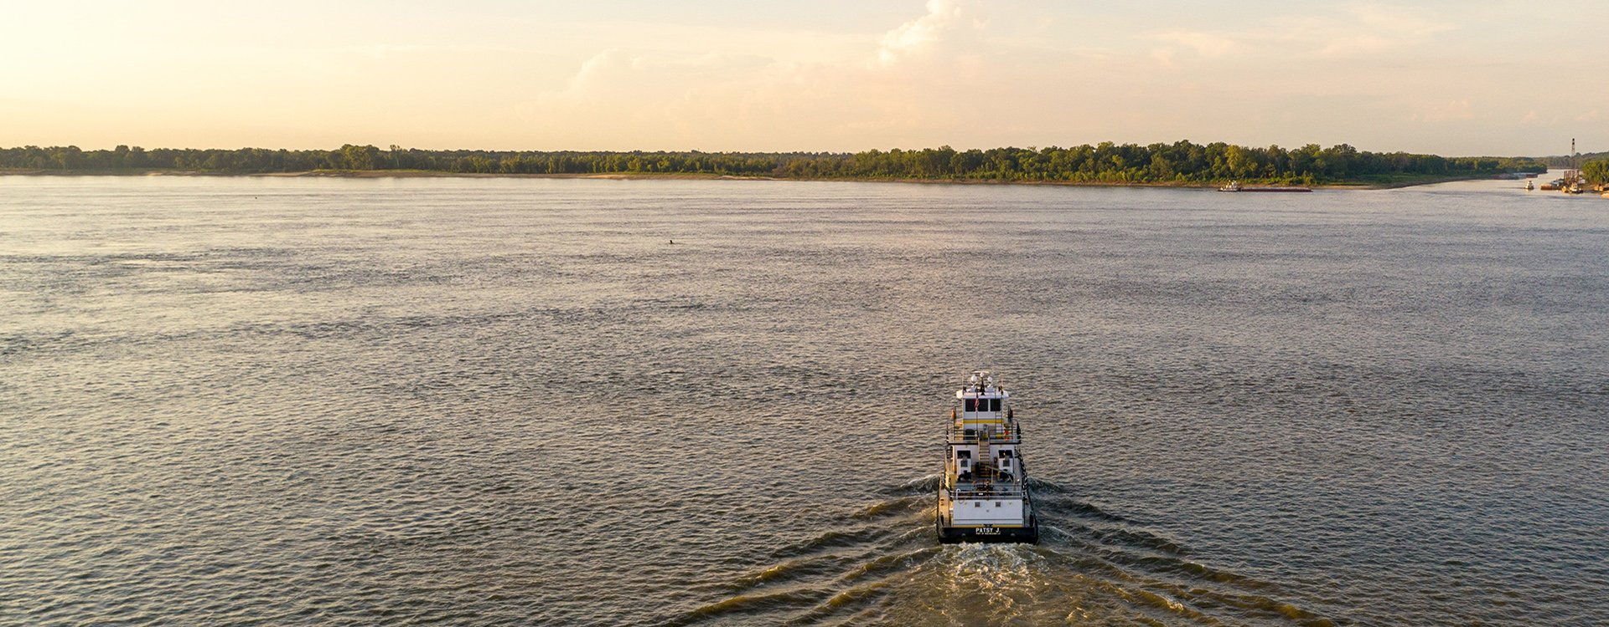
Effects of Salinity and Submergence on Spartina Alterniflora in Response to the Mid-Barataria Sediment Diversion
Ben Emery, Aidan Gort, Sergio Villamarin Gomez

Slide 2
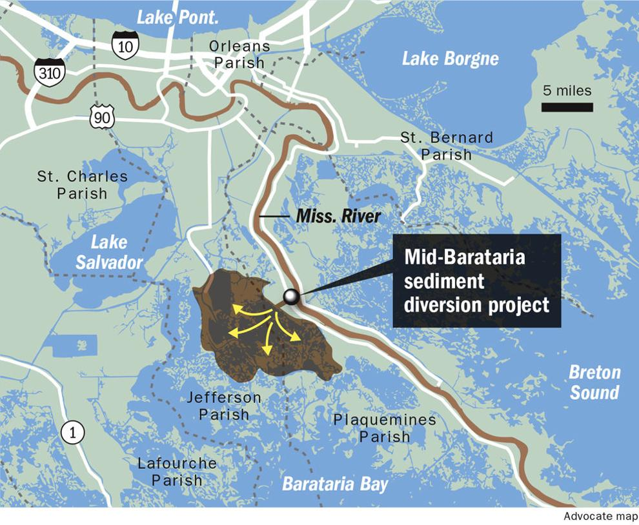
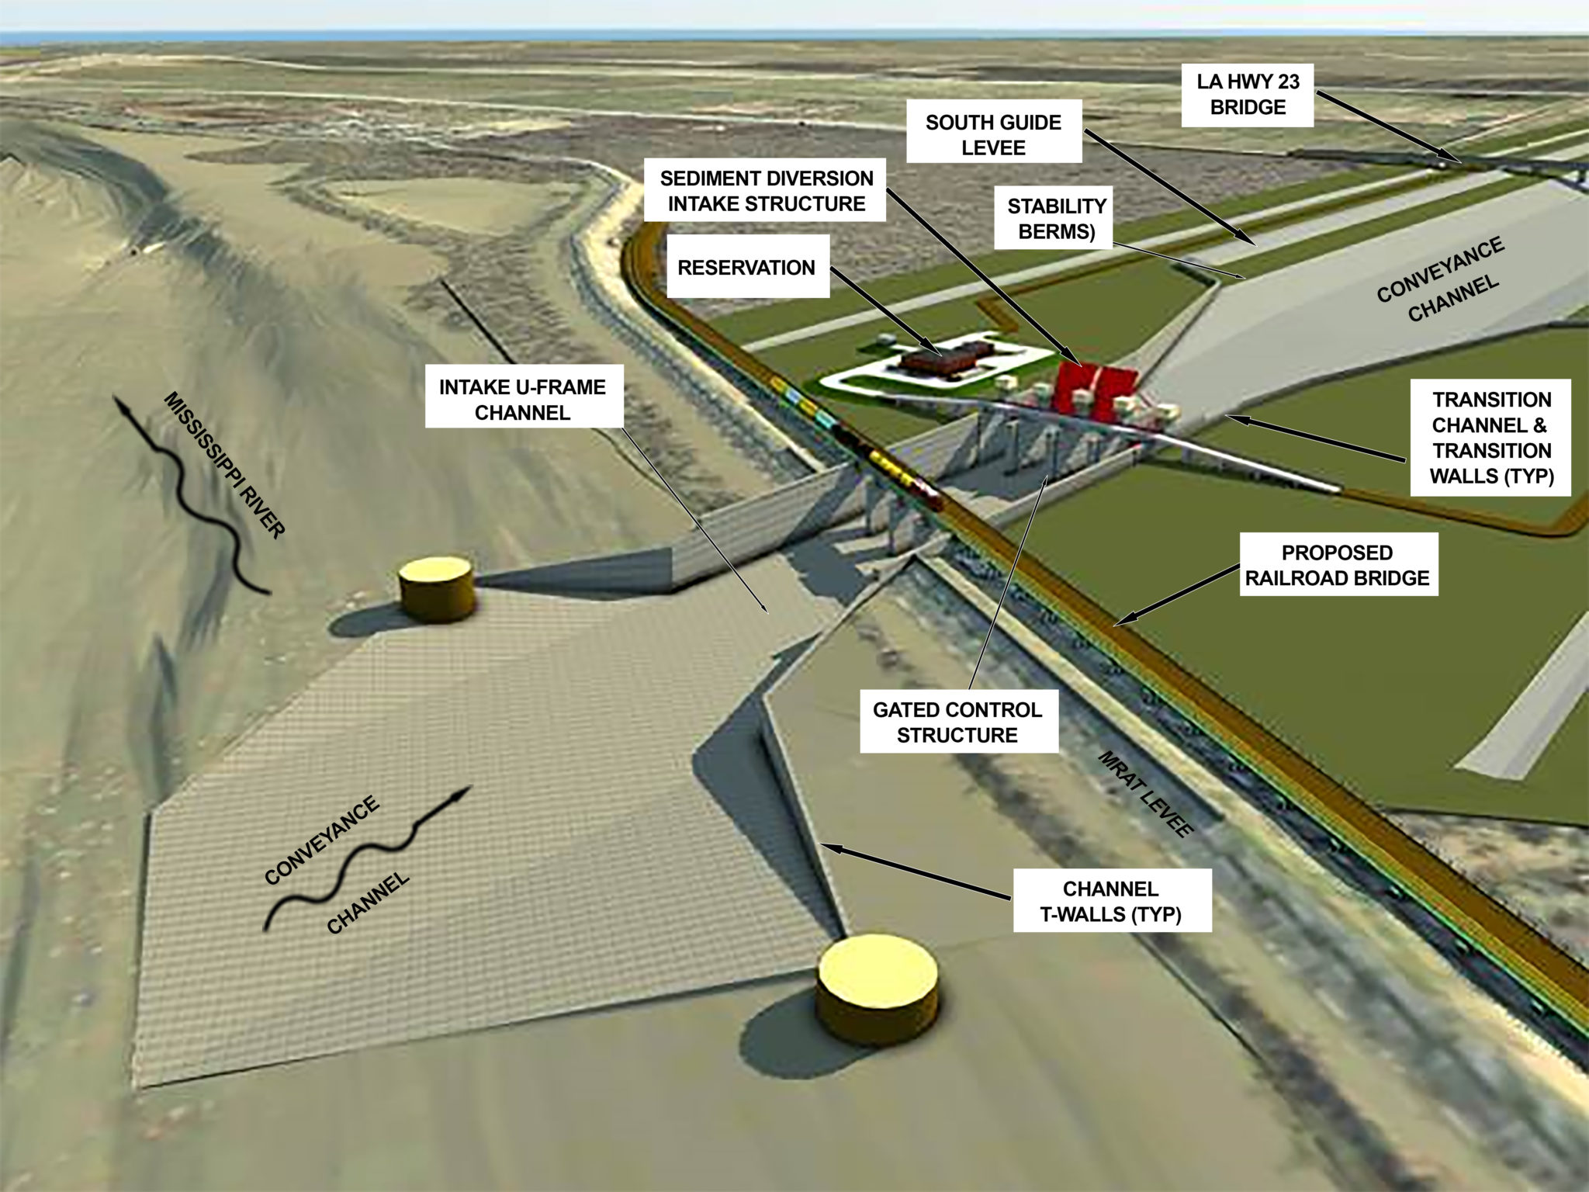
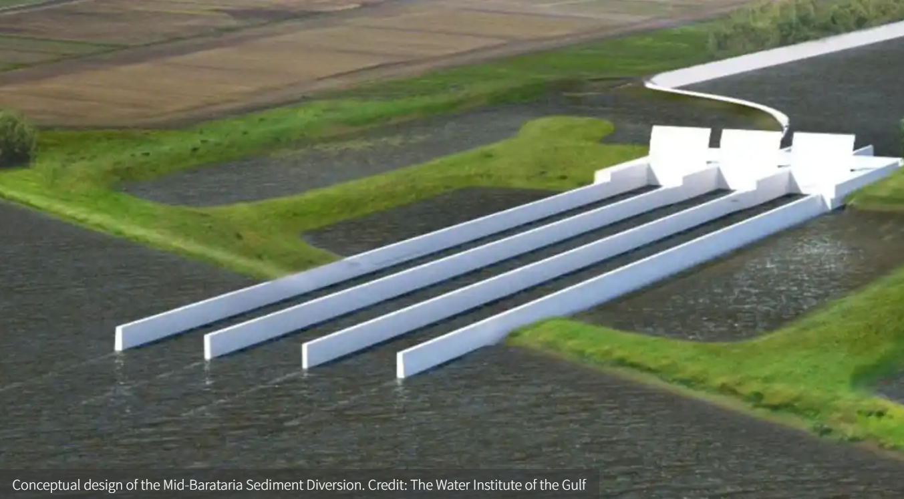
Background
Barataria Bay – 295,000 acres land lost between 1932 – 2016
Marshes degraded due to salt water intrusion/lack of fresh water/no sediment supply
Proposed Diversion Canal to reconnect MS river to the Barataria Bay. Estimated 27 sq mi land created in 50 year -period.
Diverts 75,000 cfs when MS River flows are at 1,250,000 cfs
How will submergence and salinity change, due to influx of freshwater, effect existing Spartina Alterniflora in Mid-Barataria Bay?

Slide 3
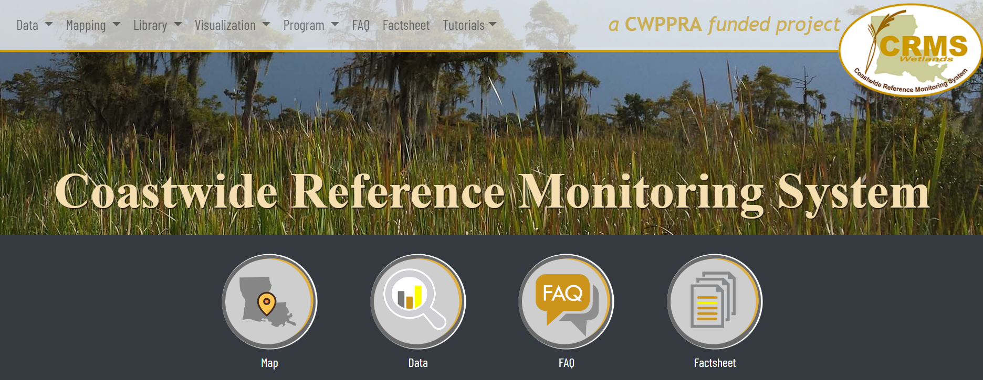
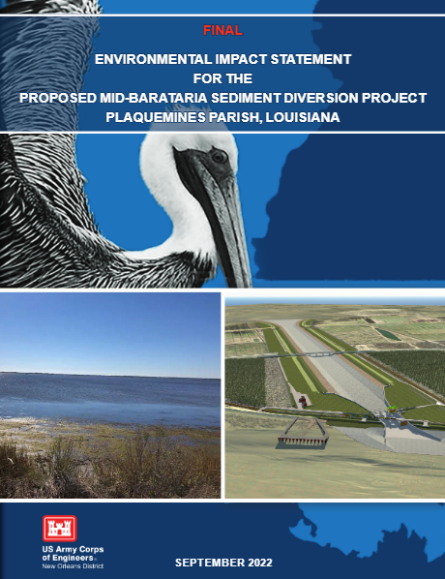
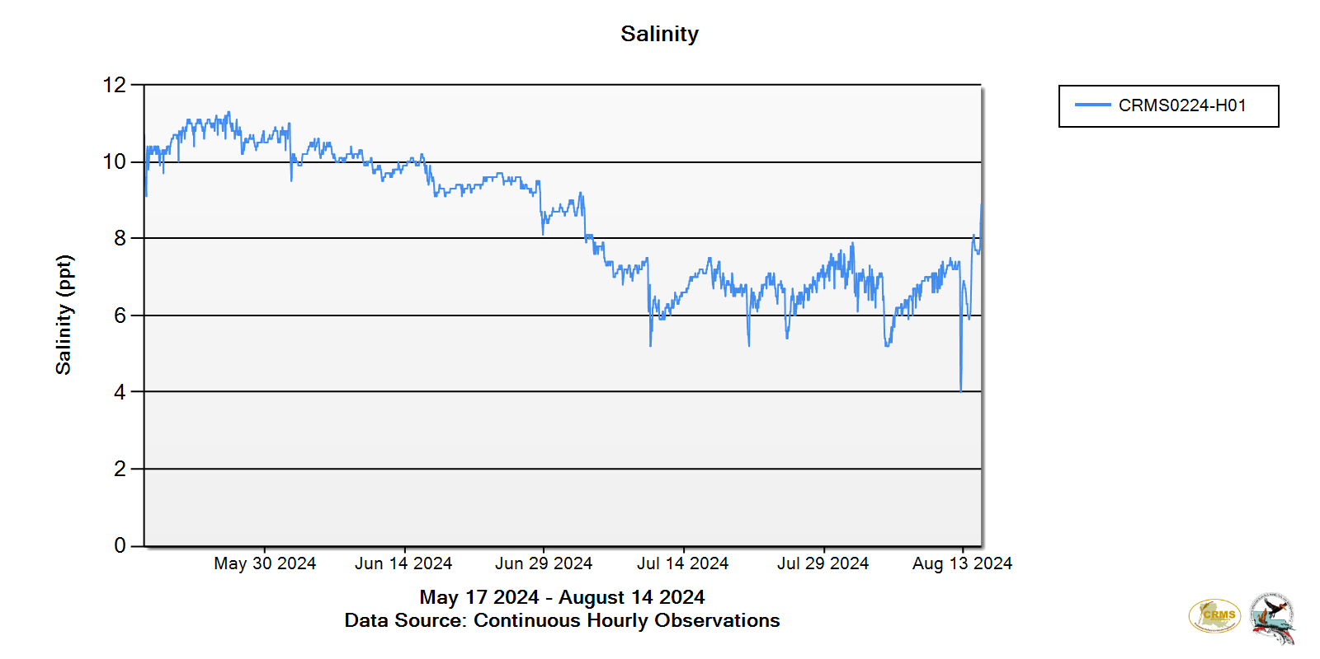
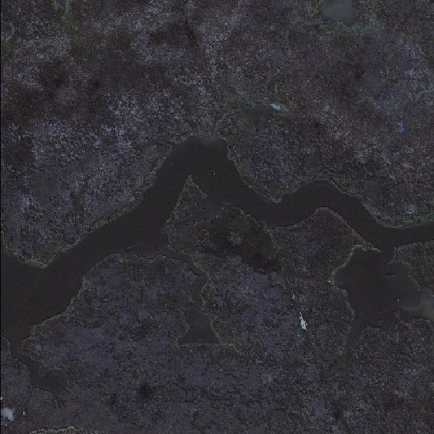
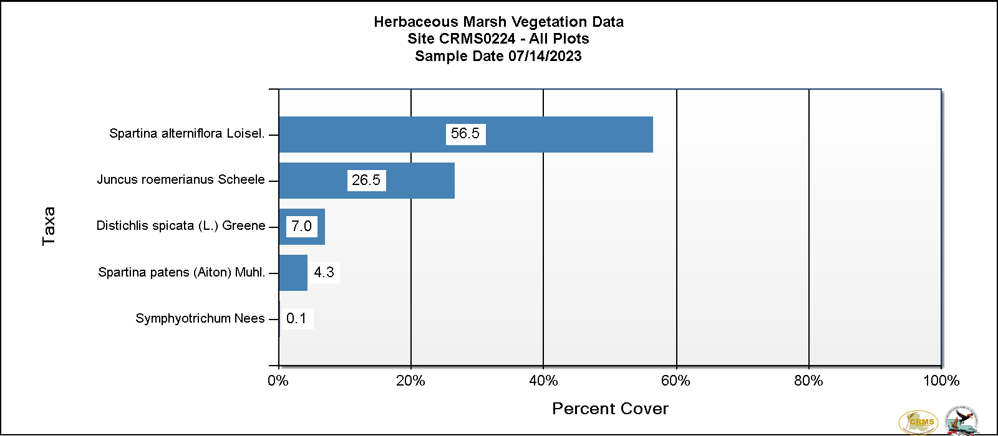

Slide 4
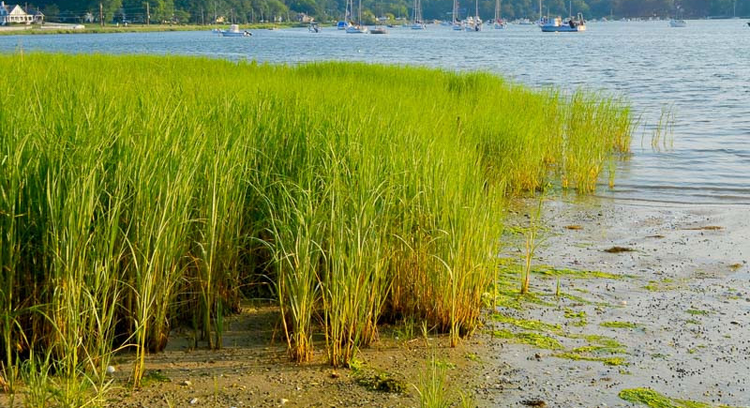
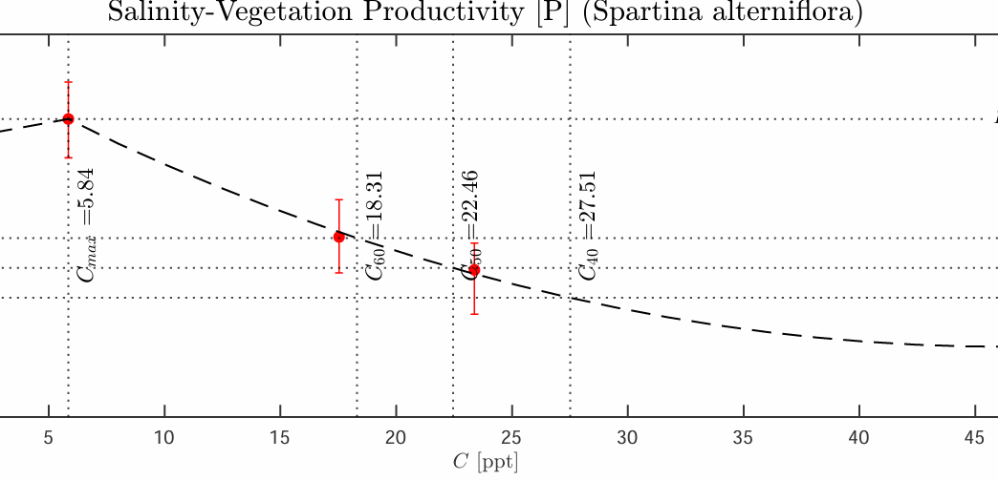
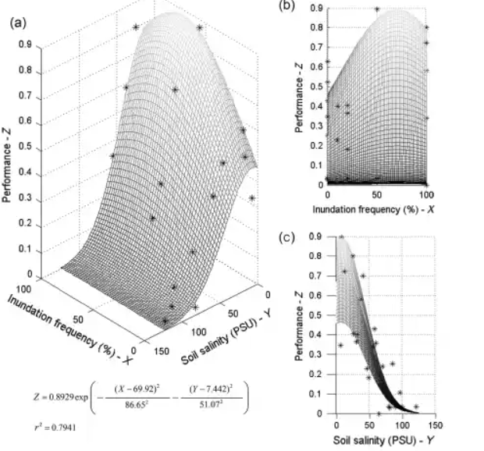
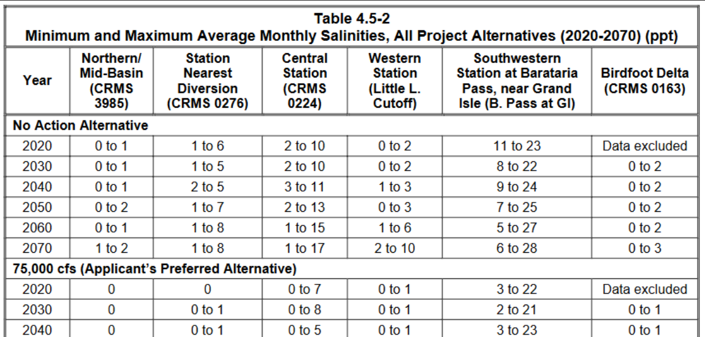

Slide 5
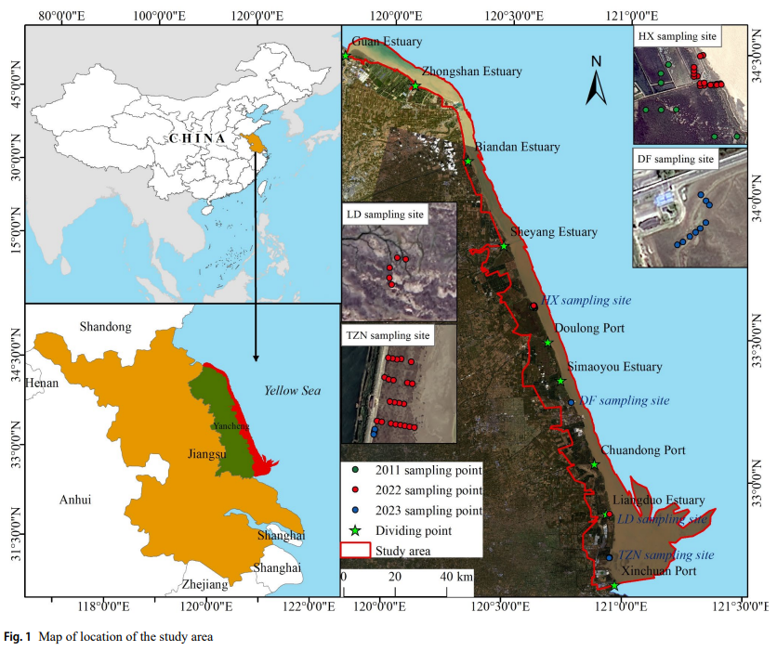
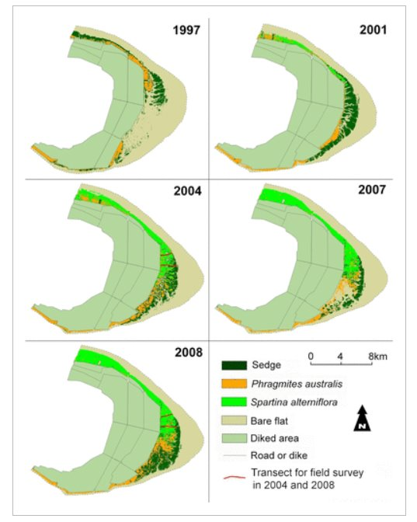
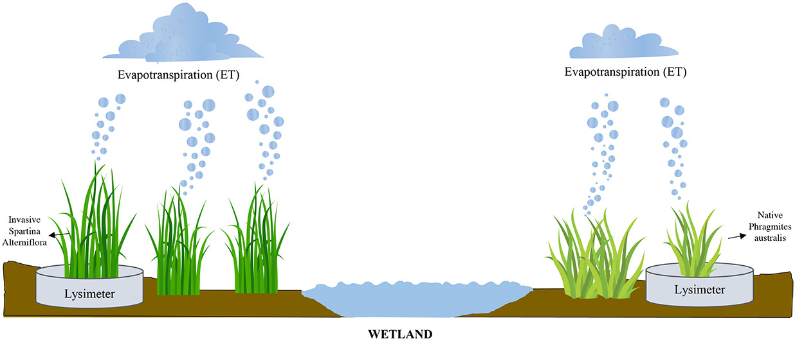
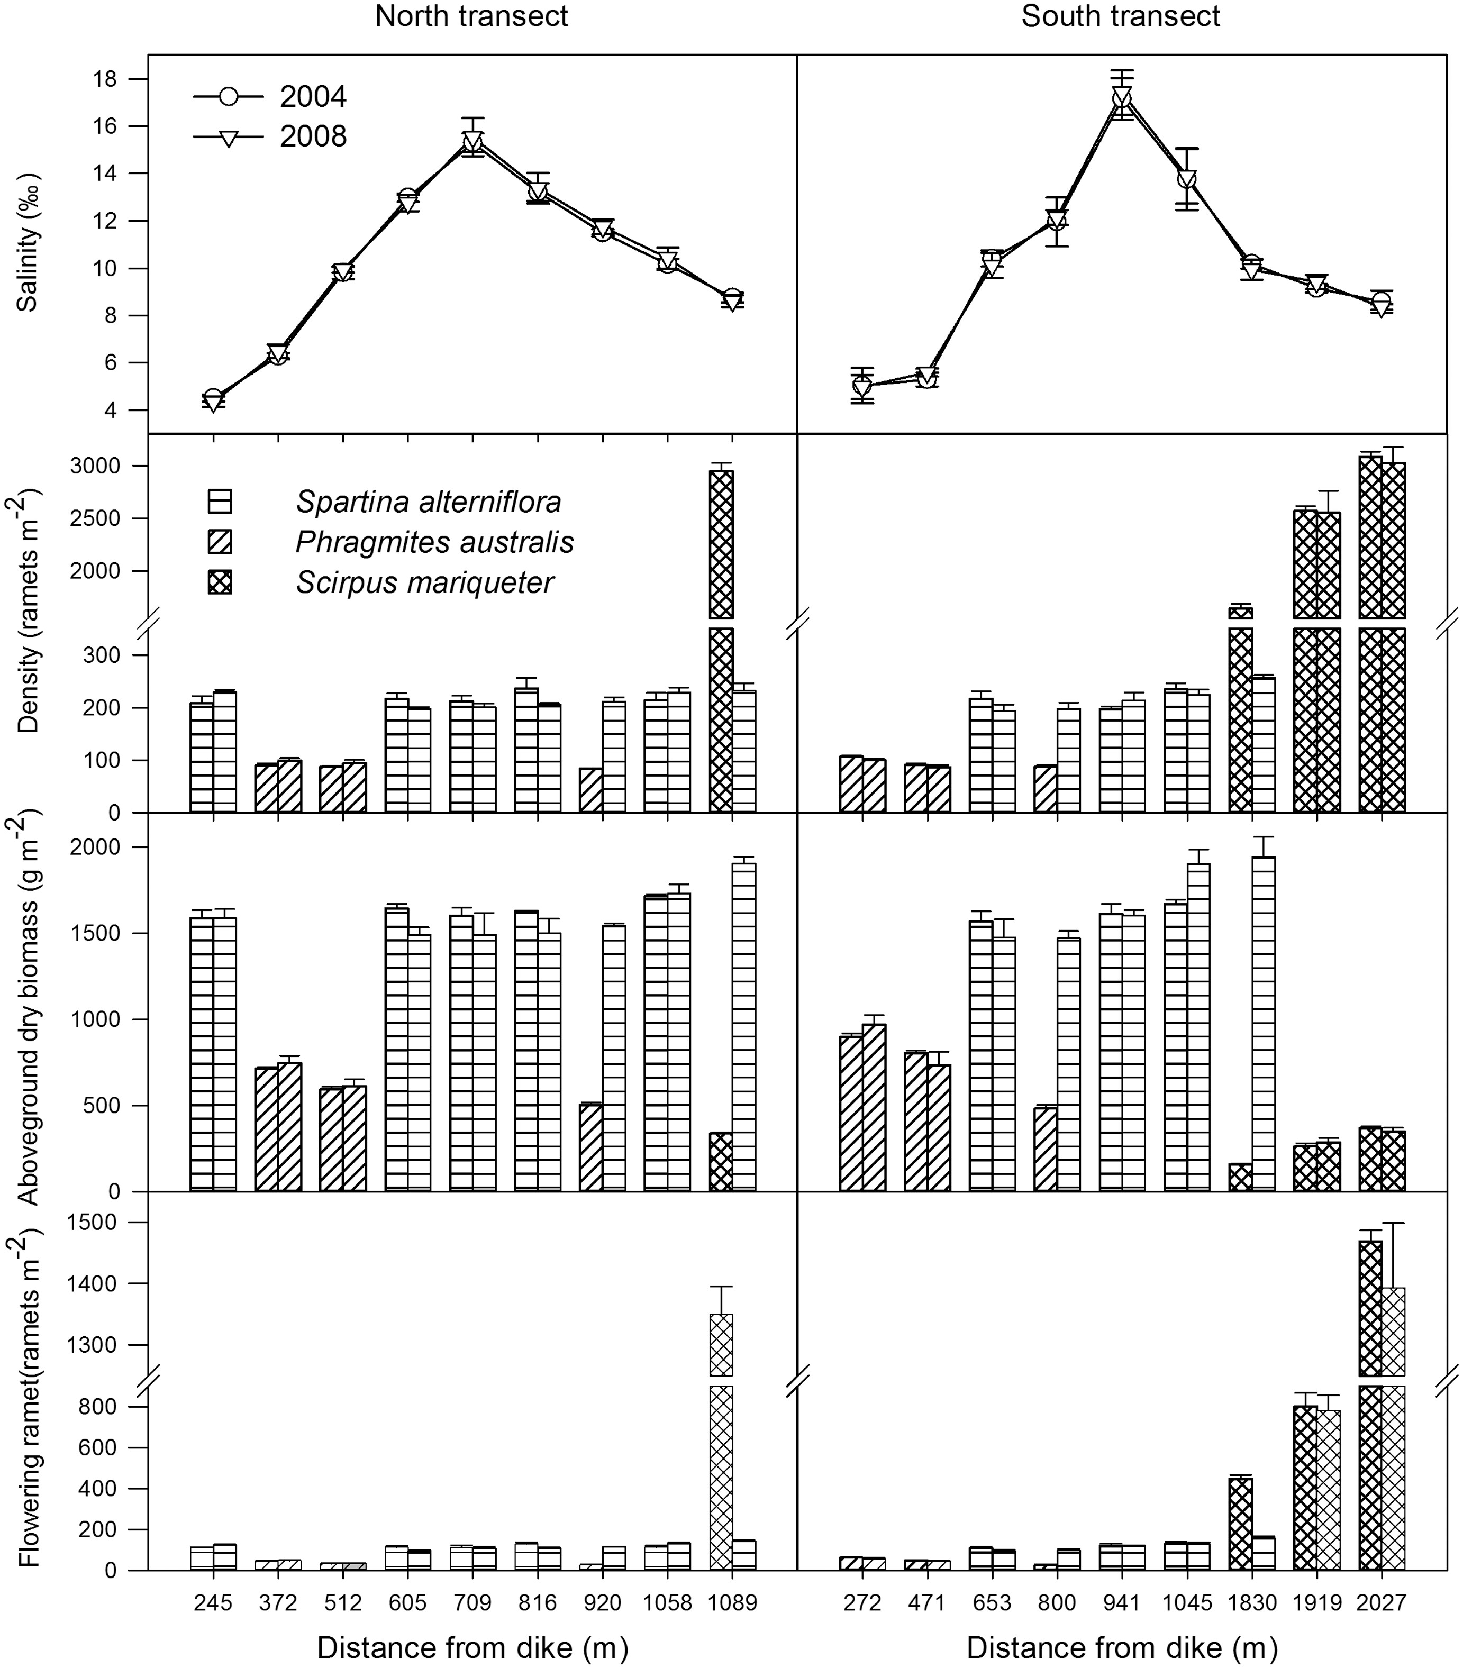
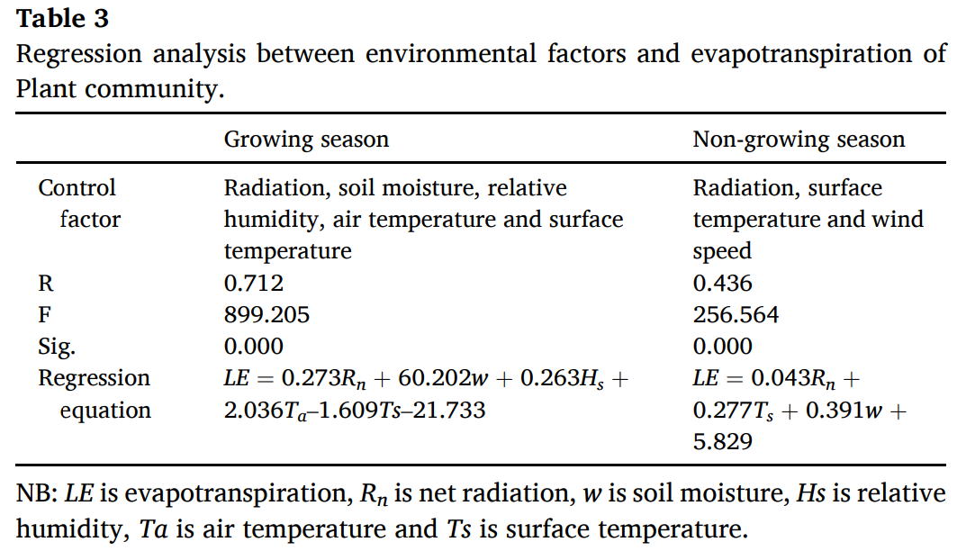

Slide 6
References
United States Army Corps of Engineers, New Orleans District & G.E.C. Inc. (September 2022). Final environmental impact statement for the proposed Mid-Barataria Sediment Diversion Project, Plaquemines Parish, Louisiana (RN 735-17c. US Army Engineer District New Orleans. https://usace.contentdm.oclc.org/digital/collection/p16021coll9/id/2943.
Smart, R. M., & Barko, J. W. (1980). Nitrogen nutrition and salinity tolerance of Distichlis spicata and Spartina alterniflora. Ecology, 61(3), 630-638. https://doi.org/10.2307/1937429.
Coastal Protection and Restoration Authority (CPRA) of Louisiana. 2024. Coastwide Reference Monitoring System-Wetlands Monitoring Data. Retrieved from Coastal Information Management System (CIMS) database. http://cims.coastal.louisiana.gov. Accessed 28 October 2024.
Taitiya Kenneth Yuguda, Yueming Wu, Zhanrui Leng, Guifeng Gao, Guanlin Li, Zhicong Dai, Jian Li, Daolin Du, Impact of Spartina alterniflora invasion on evapotranspiration water loss in Phragmites australis dominated coastal wetlands of east China, Ecological Engineering, Volume 179, 2022, 106605, ISSN 0925-8574, https://doi.org/10.1016/j.ecoleng.2022.106605.
Bu, N., Qu, J., Li, Z., Li, G., Zhao, H., Zhao, B., Li, B., Chen, J., & Fang, C. (2015). Effects of Spartina alterniflora Invasion on Soil Respiration in the Yangtze River Estuary, China. PLOS ONE, 10(3), e0121571. https://doi.org/10.1371/journal.pone.0121571
Tang, L., Gao, Y., Li, B., Wang, Q., Wang, C.-H., & Zhao, B. (2014). Spartina alterniflora with high tolerance to salt stress changes vegetation pattern by outcompeting native species. Ecosphere, 5(9), art116. https://doi.org/10.1890/ES14-00166.1
Howes, B. L., Dacey, J. W. H., & Goehringer, D. D. (1986). Factors Controlling the Growth Form of Spartina Alterniflora: Feedbacks Between Above-Ground Production, Sediment Oxidation, Nitrogen and Salinity. Journal of Ecology, 74(3), 881–898. https://doi.org/10.2307/2260404
Mao, L., Mishra, D. R., Hawman, P. A., Narron, C. R., O’Connell, J. L., & Cotten, D. L. (2023). Photosynthetic performance of tidally flooded Spartina alterniflora salt marshes. Journal of Geophysical Research: Biogeosciences, 128(3). https://doi.org/10.1029/2022JG007161
Matsuda et al., 2023. Effects of salinity, temperature, and immersion conditions on seed germination of invasive Spartina alterniflora Loisel (smooth cordgrass) in Japan. Reg. Stud. Mar. Sci., 57 (2023), p. 8. https://doi.org/10.1016/j.rsma.2022.102738
Qi, M., T. Sun, H. Zhang, M. Zhu, W. Yang, D. Shao, and A. Voinov. 2017. Maintenance of salt barrens inhibited landward invasion of Spartina species in salt marshes. Ecosphere 8(10):e01982. 10.1002/ecs2.1982. DOI:10.1002/ecs2.1982
CITE EMMANUEL’S GRAPHS

